Slide 1
19CSE202 Data Base Management System
Project Title
Database System For a Music Company
Team Members(TEAM-19)
Lebaka Kullayi Swamy Reddy – CSE20085
N.N.V.Siva Sai Raghu – CSE20109
Pusapati Ramakrishna Raju – CSE20134
Tripuramallu Pramodh – CSE20183

Slide 2
Problem Statement
Database for a Music Company to store details of songs, artists, albums in an ordered manner.
Admin manages back-end and creates new pages.
Music Director can upload the song file and thumbnail up-to 8MB.
This is very lightweight and easy to access.

Slide 3
Agenda
Abstract
The main aim of this project is to develop a database system for the Music Company to maintain all the data efficiently at less cost.
This database can be shared to the online website and application’s affiliated to the Music Company.
This database can store and represent the data to their respective artists and albums.

Slide 4
This database stores the music in .mp3 format and can change the playback speed of song.
This site is very light weight and the user can download the respective songs.

Slide 5
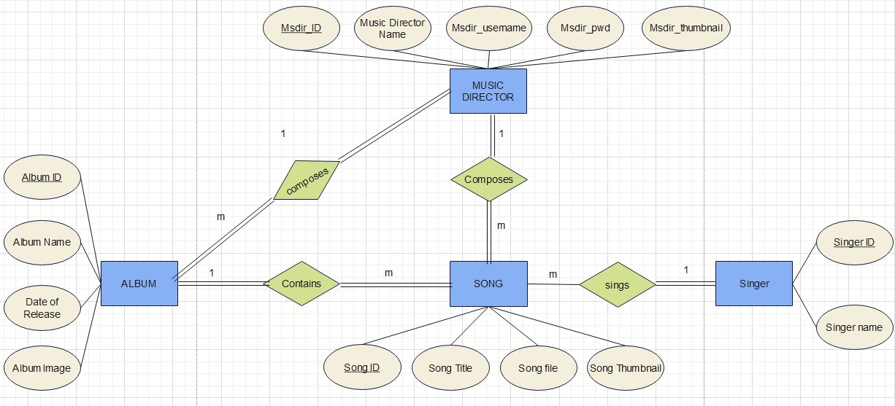
ER Diagram

Slide 6
TABLE
CONVERSION

Slide 7
SINGER
SINGER_ID | SINGER_NAME

Slide 8
MUSIC DIRECTOR
MSDIR_ID | MSDIR_NAME | MSDIR_USERNAME | MSDIR_PWD | MSDIR_THUMB NAIL

Slide 9
ALBUM
ALBUM_ID | ALBUM_NAME | DATE_OF_RELEASE | ALBUM_IMAGE | MSDIR_ID

Slide 10
SONG
SONG_ID | SONG_TITLE | SONG_FILE | SONG_THUMB NAIL | MSDIR_ID | SINGER_ID | ALBUM_ID

Slide 11
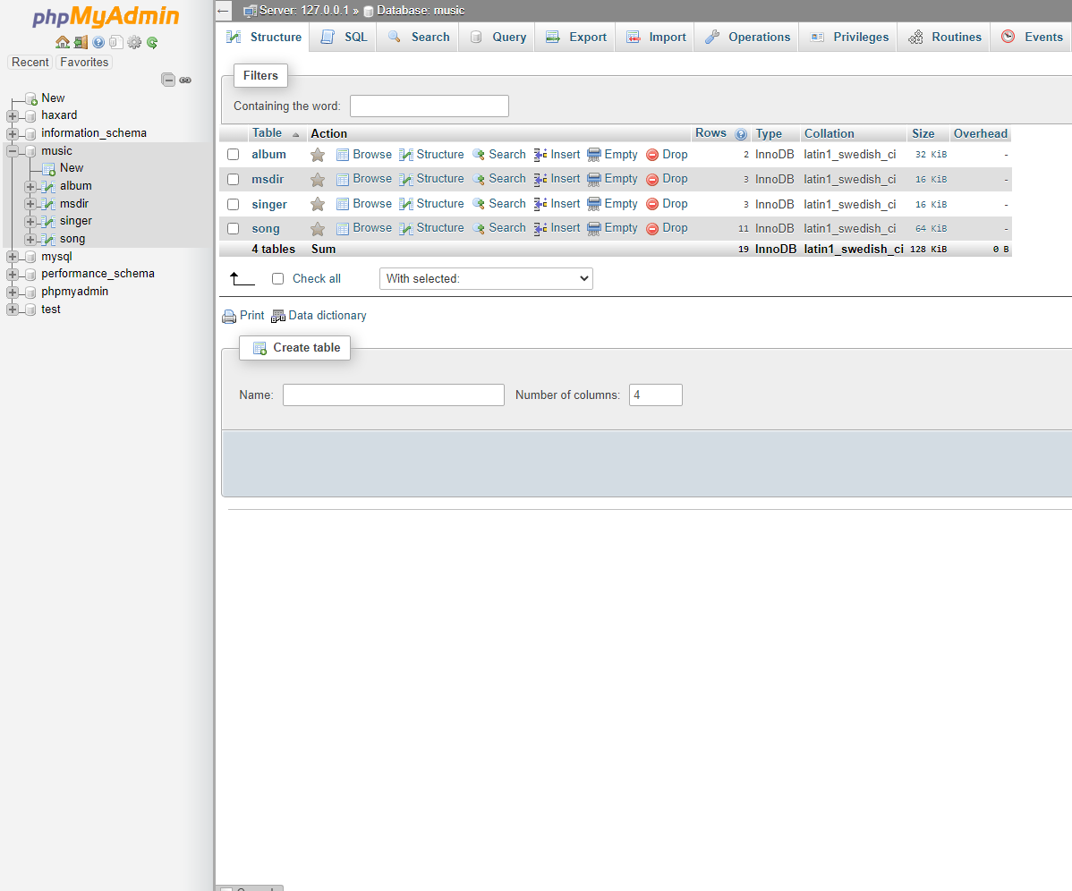
Music Database

Slide 12
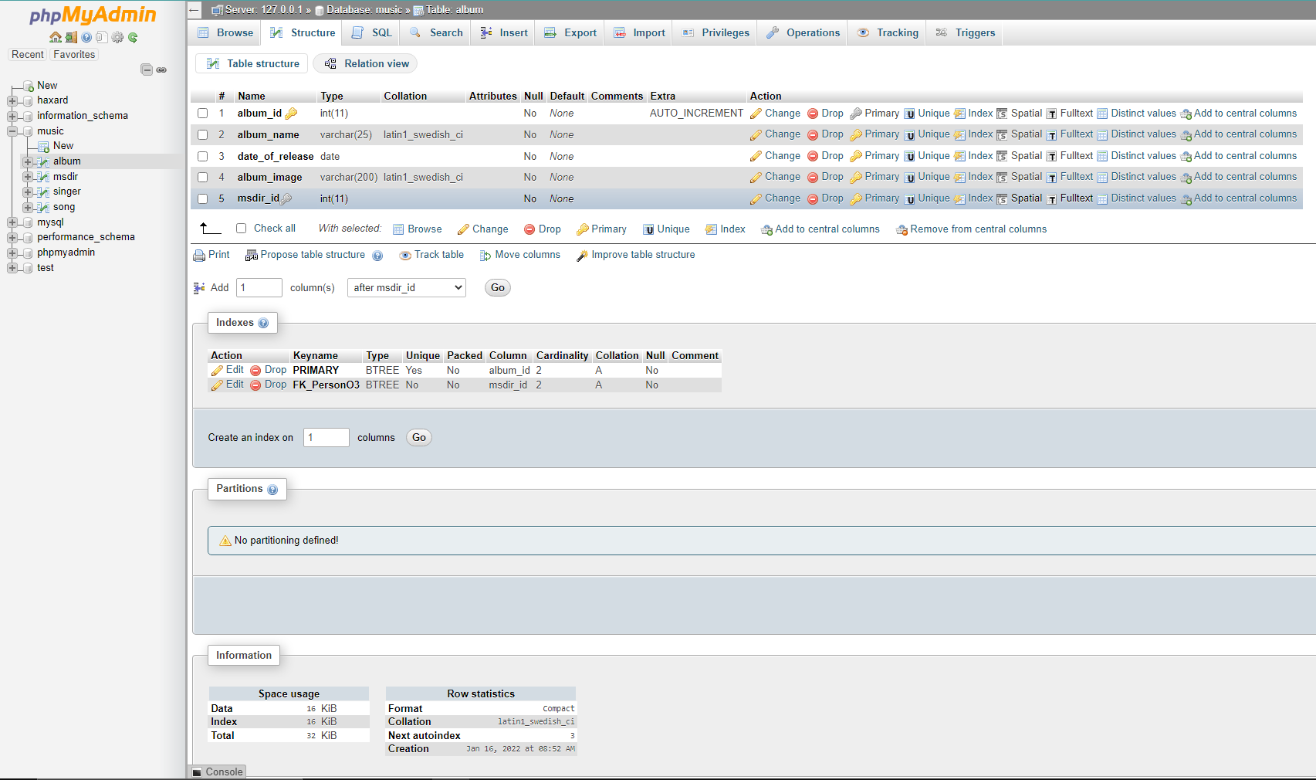
Album Table

Slide 13
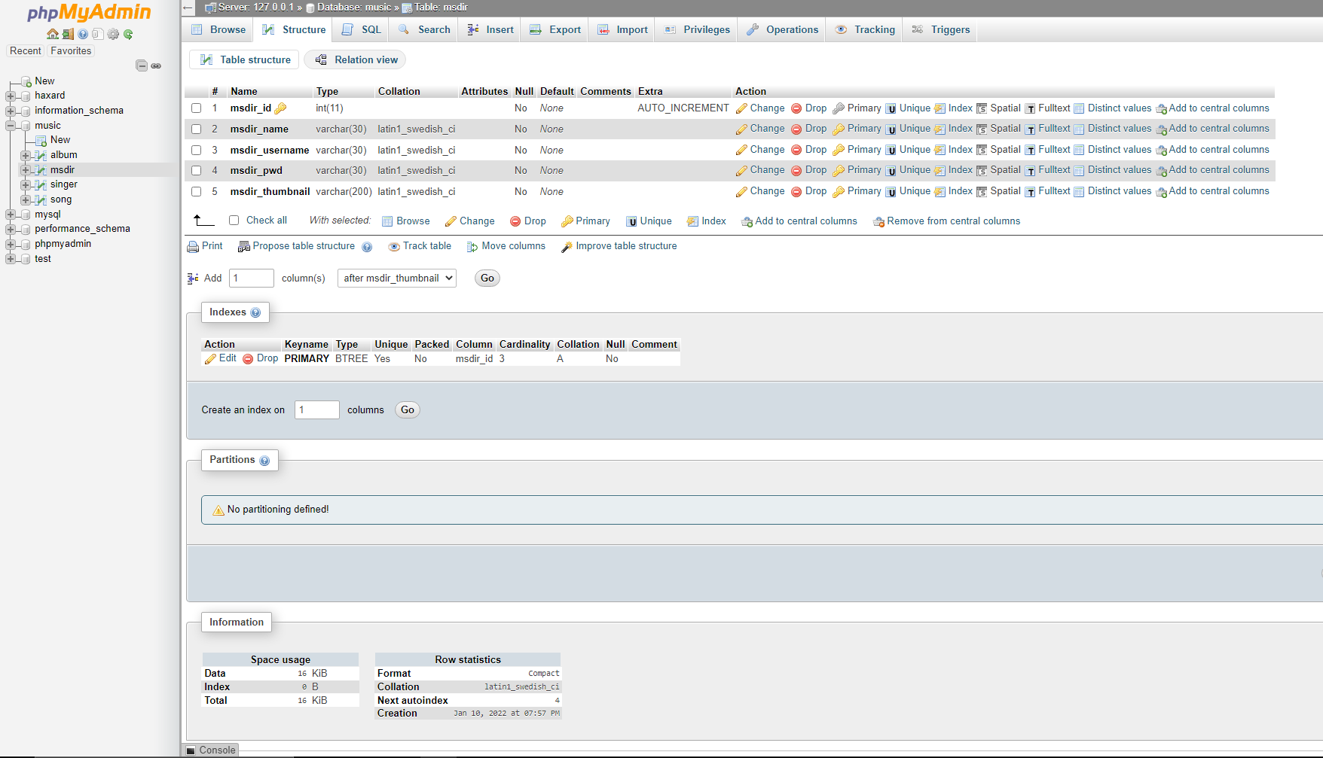
Music Director Table

Slide 14
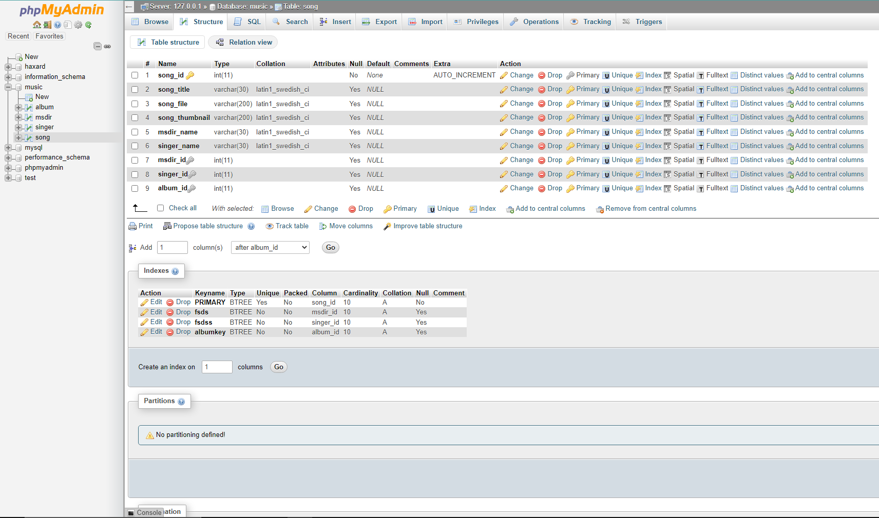
Song Table

Slide 15
Front End
HTML
CSS
JavaScript

Slide 16
Back End
MySQL
Apache Server
PHP

Slide 17
THANK YOU

